Slide 1
Introduction of Multicopter
—— 龚志豪

Slide 2
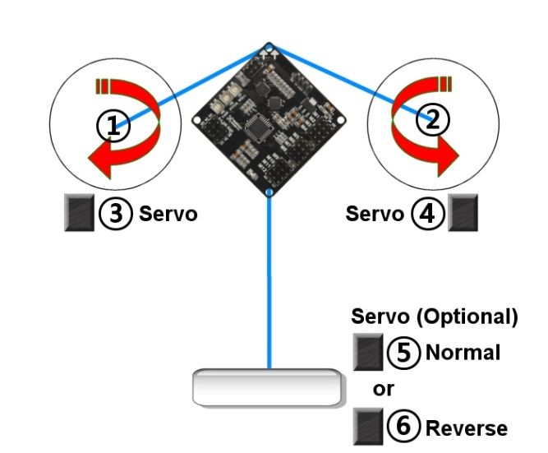
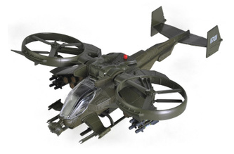
Classification
Twincopter：

Slide 3
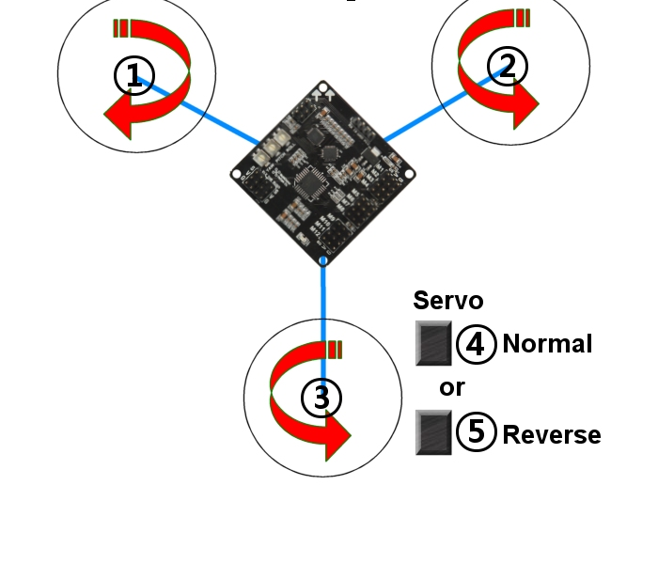
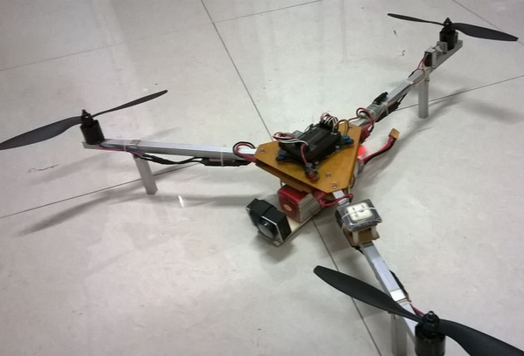
Classification
Tricopter：

Slide 4
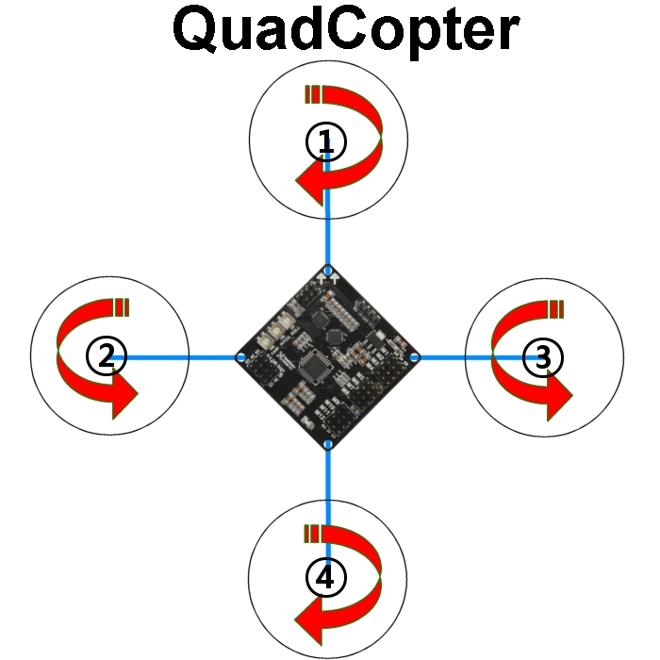
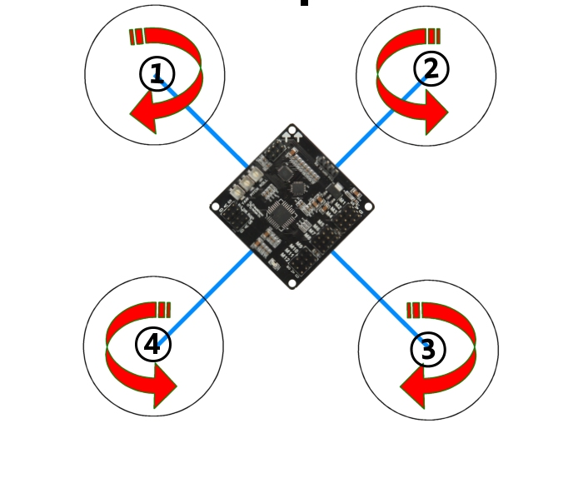
Classification
Quadcopter：

Slide 5
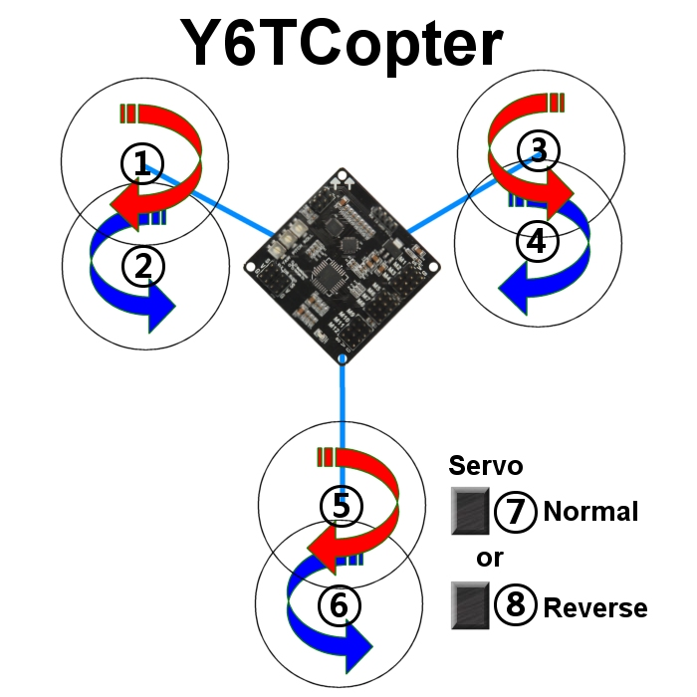
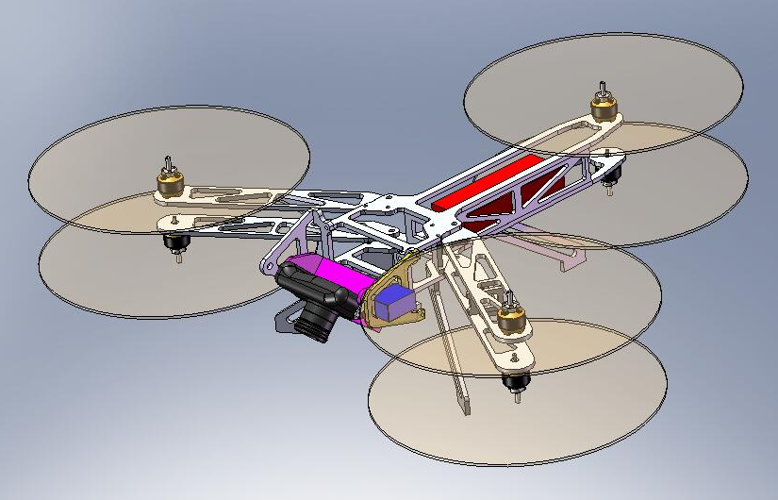
Classification
Y6-copter：

Slide 6
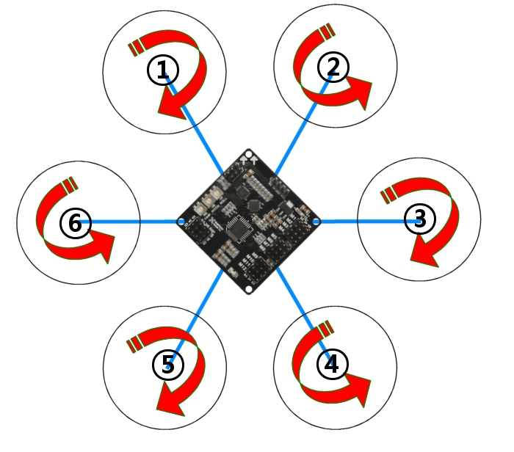
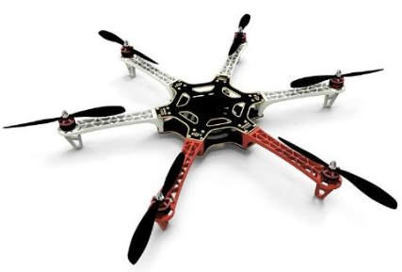
Classification
Hexacopter：

Slide 7
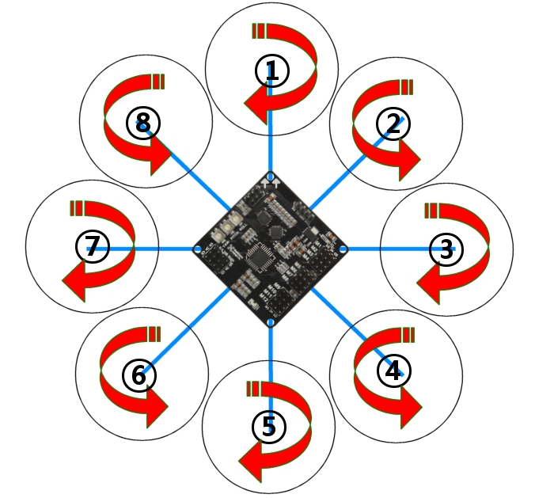
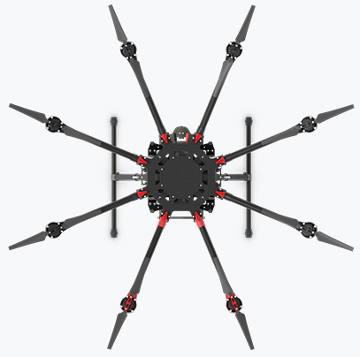
Classification
Octocopter：

Slide 8
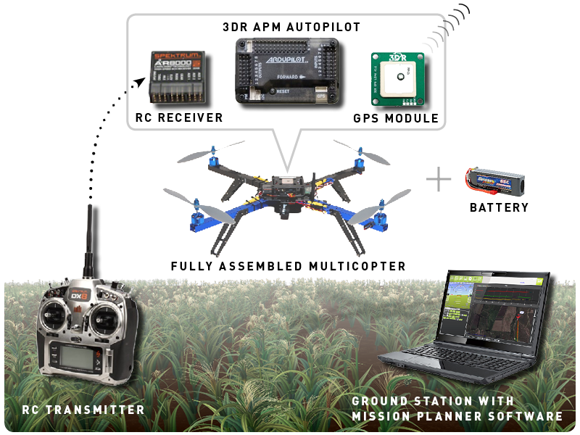
Composition

Slide 9
Composition

Slide 10
Micro-multicopter VS Ordinary multicopter
 | micro Multicopter | Ordinary multicopter
Composition | Simple | Complex
Cost | 200~1000¥ | 1500~30000¥
Carrying Capacity | 10g | 0.5Kg~2Kg
Application | Research & Entertainment | Aerial photography Security Agriculture
Algorithm | Same | Same
Battery life | 5~10min | 15~25min
Safety Factor | Safe | Dangerous
Operation | Diffcult to control | Easy to control

Slide 11
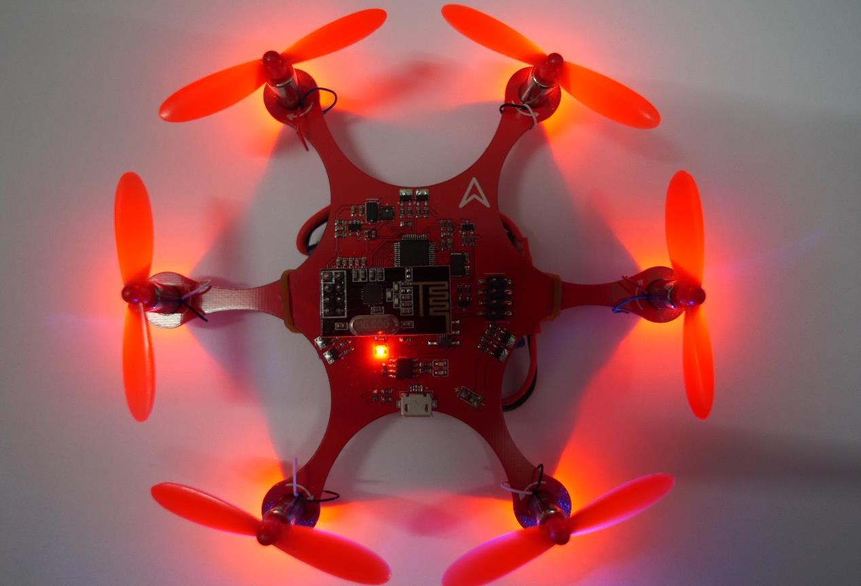
FI-Explorer

